Slide 1



Week 3 Internship Assessment – (Group-1A)
Cost Optimisation Analysis: Recommending Ad Campaign Discontinuation for Superhero U Event

Slide 2


Team Introduction
Team Lead: Ankita Datta
Team Members
V L Bhanu Prakash Reddy
Harshit Kujur
Chittepu Manaswini
Nisha
R Geeta Sri
Aruneswaran A B

Slide 3
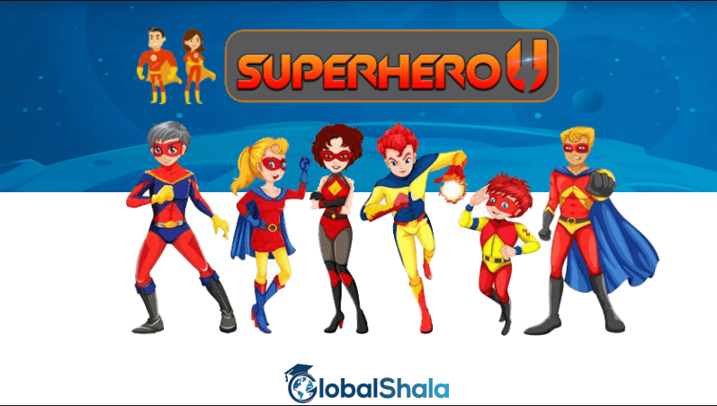
What is Superhero U ?
GlobalShala ran a promotional campaign for the event called Superhero U on Facebook. The Promoting Group at GlobalShala has information from Facebook on the advertisement campaign they ran for the Superhero U occasion.

Slide 4

Superhero U is all about...4Is !!!
Imagine
Illustrate
Innovate
Inspire

Slide 5

What is a Facebook Ad?
Facebook is a social networking platform that allows users to connect and share text, photos, and videos. Individuals and businesses can create an account and set up a profile page for free. However, Facebook contains ads to help pay for its services. This allows companies like GlobalShala to pay for Facebook advertising campaigns.

Slide 6
The ad type used by GlobalShala is a simple image ad, also known as a "link click" ad.
These advertisements consist of several parts:
A profile picture and profile name pointing to the GlobalShala profile page.
Some descriptive text.
Buttons to like, comment, and share the ad.
GlobalShala ran ads aimed at her two different audiences: 'interns' and 'educators and principals'.

Slide 7

KPIs in the dataset
Analysis of Campaign Cost.
Analysis of Reach of the each Campaign.
Analysis of Reach and Impressions by Campaign.
Analysis of Individual Campaigns reaches every age group.
Analysis of Amount spent for every campaign.
Analysis of the Sum of ULC & CPR by Campaign

Slide 8

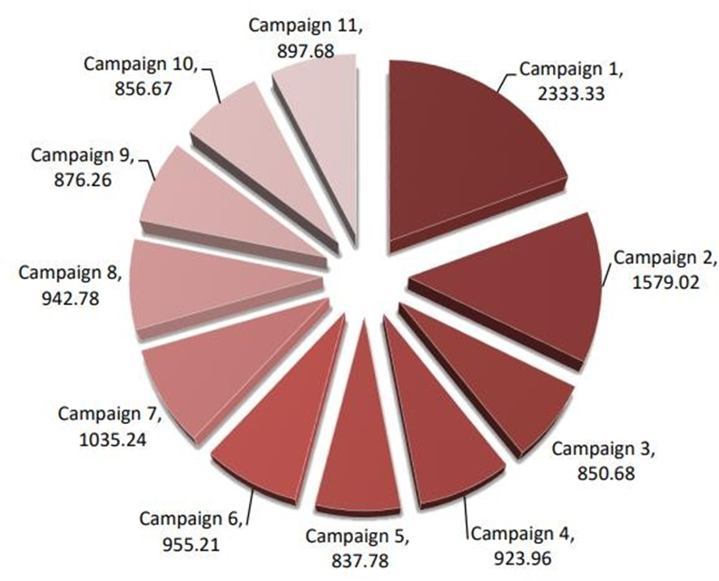
Analysis of Campaign Cost
Campaign 1 had the highest spending at 2,333.33 INR, 178.51% more than Campaign 5's 837.78 INR.
Campaign 1 contributed 19.30% of the total spending.
Spending across all 11 campaigns ranged from 837.78 to 2,333.33 INR

Slide 9
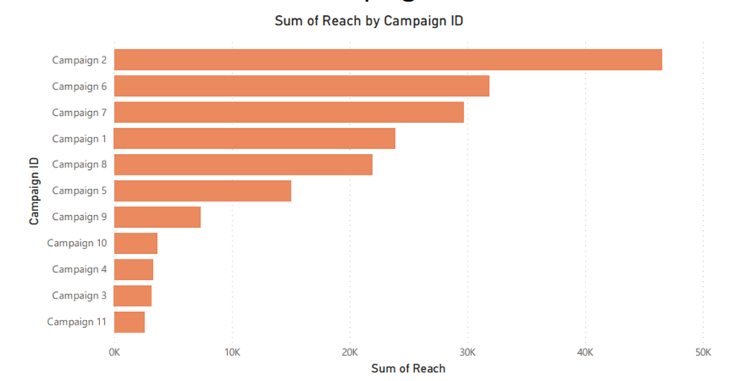
Analysis of Reach By Campaign ID
Campaign 2 represented 24.62% of the total Sum of Reach.
The greatest difference between Sum of Impressions and Sum of Reach occurred in Campaign 7, with Sum of Impressions being 35,547 higher than Sum of Reach.

Slide 10
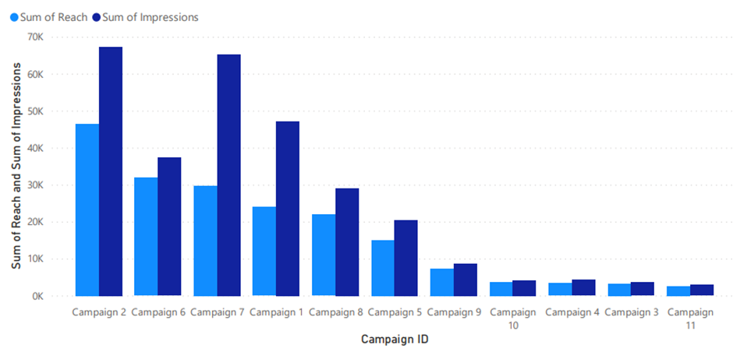
Analysis of Reach and Impressions By Campaign ID
At 46,494, Campaign 2 achieved the highest Sum of Reach, representing a notable 1,719.73% increase compared to Campaign 11, which registered the lowest Sum of Reach at 2,555. Furthermore, it is observed that Sum of Reach and the total Sum of Impressions exhibit a positive correlation with each other.
Campaign 2 contributed to 24.62% of the overall Sum of Reach, underscoring its substantial impact. The most significant divergence between Sum of Impressions and Sum of Reach occurred at Campaign 7, where Sum of Impressions exceeded Sum of Reach by 35,547.

Slide 11
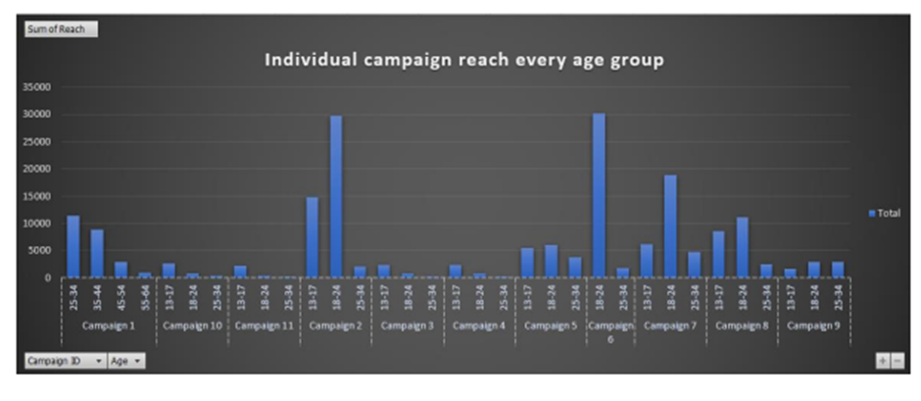
Analysis of Indivisual Campaign Reach of the
Age Group
The age group 18-24 achieved the highest total Sum of Reach, reaching 101,035, with 13-17 following at 45,665 and 25-34 at 29,651.
Within the age group breakdown, Campaign 6 accounted for 15.94% of the overall Sum of Reach.
Regarding the average Sum of Reach, 18-24 exhibited the highest value at 10,103.50, trailed by 13-17 at 5,073.89 and 25-34 at 2,695.55.

Slide 12
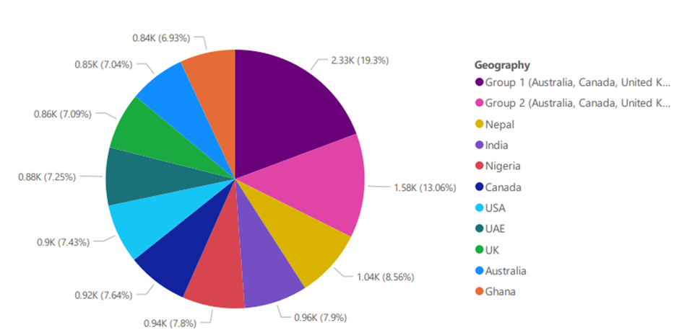
Analysis of Amount spent for every
campaign on location
Group 1 (Australia, Canada, United Kingdom, Ghana, Nigeria, Pakistan, United States) had the highest Sum of Amount Spent in INR at 2,333.33, which was 178.51% higher than Ghana's lowest Sum of Amount Spent at 837.78 INR.
Group 1 accounted for 19.30% of the total Sum of Amount Spent in INR.
Across all 11 Geographies, the Sum of Amount Spent in INR ranged from 837.78 to 2,333.33.

Slide 13
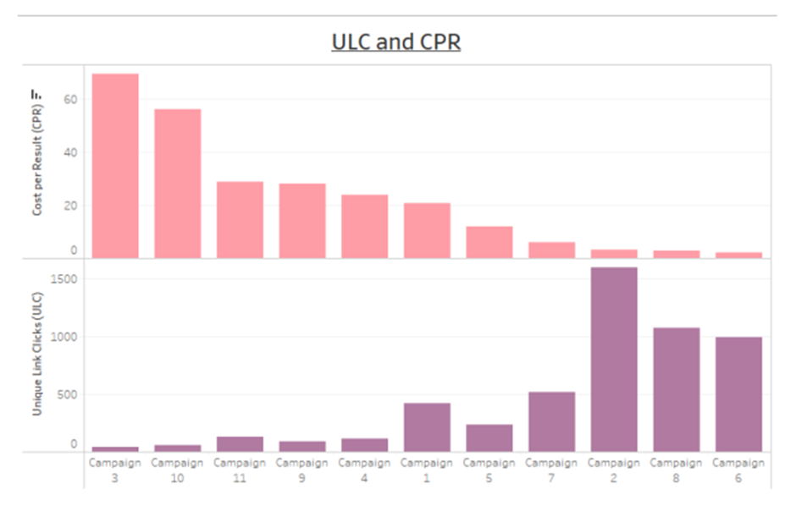
Analysis of Sum of ULC & CPR by Campaign
﻿At 1595, Campaign 2 had the highest Sum of Unique Link Clicks (ULC) and was 3,525.00% higher than Campaign 3, which had the lowest Sum of Unique Link Clicks (ULC) at 44.
﻿﻿﻿﻿﻿﻿
Campaign 2 accounted for 30.34% of Sum of Unique Link Clicks (ULC).﻿﻿﻿﻿﻿﻿Across all 11 Campaign ID, Sum of Unique Link Clicks (ULC) ranged from 44 to 1595.﻿﻿﻿﻿﻿
﻿At 69.33, Campaign 3 had the highest Sum of Cost per Result (CPR) and was 3,182.46% higher than Campaign 6, which had the lowest Sum of Cost per Result (CPR) at 2.11.
Campaign 3 accounted for 27.50% of Sum of Cost per Result (CPR). Across all 11 Campaign ID, Sum of Cost per Result (CPR) ranged from 2.11 to 69.33.

Slide 14

Insights
Campaign Performance Analysis: After a comprehensive assessment, campaigns 6 and 8 are found to have underperformed in terms of CPR, while campaigns 2 and 8 demonstrated poor CPC performance.
Impression and Reach Evaluation: Campaigns 11 and 3 exhibit lower impressions and reach compared to campaigns 2 and 7.
Target Demographic Engagement: Campaigns 3, 4, 10, and 11 experienced notable reach decline within age groups 13-17, 18-24, 45-54, and 55-64, indicating varied engagement rates across age segments.
Budget Allocation Insights: The distribution of the budget reveals Campaign 5 with the minimum funds outperforming Campaign 3 in Ghana. Campaigns 9 and 10 achieved exceptional results despite comparatively smaller budgets, highlighting strategic planning's role.

Slide 15
Conclusion
Campaign Removal Consideration: Campaign 3's high CPR and inefficient resource utilization make its removal justifiable. On the other hand, retaining Campaign 11 might be prudent if its performance aligns better with specific goals and delivers more congruent outcomes.
These findings emphasize the significance of strategic planning, target audience alignment, and performance metrics in campaign success, suggesting that budget size alone does not dictate triumph.
Therefore, removing campaigns 3 and 11 could lead to cost reduction without compromising overall effectiveness.

Slide 16

THANK YOU

